Slide 1
Hoisting
console.log(a)
var a = 10
會輸出undefined而不是ReferenceError: a is not defined，這種現象就叫做 Hoisting，變數的宣告被「提升」到最上面去了。

Slide 2
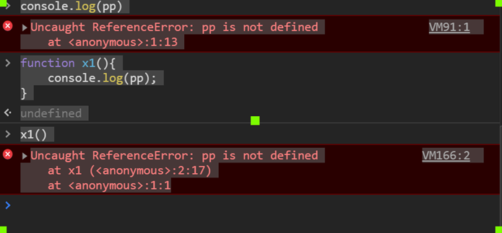

Slide 3
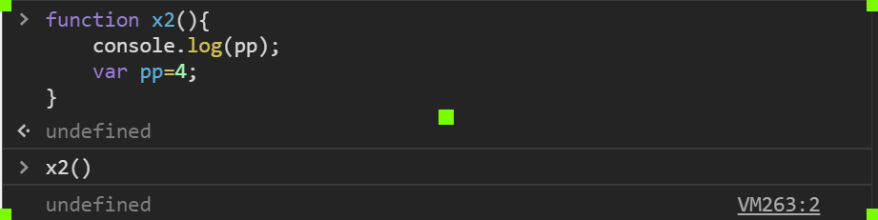
也可以說compiler 知道後面會宣告pp,因此,已經自行宣告了一個變數位置
2-phase compiling

Slide 4
function varvslet() {
console.log(i); // i 是 undefined 的，因為 hositing
// console.log(j); // ReferenceError: j 沒有被定義
for( var i = 0; i < 3; i++ ) {
console.log(i); // 0, 1, 2
};
console.log(i); // 3
// console.log(j); // ReferenceError: j 沒有被定義
for( let j = 0; j < 3; j++ ) {
console.log(j);
};
console.log(i); // 3
// console.log(j); // ReferenceError: j 沒有被定義
}

Slide 5
function test() {
console.log(i); // i 是 undefined 的，因為 hositing
// console.log(j); // ReferenceError: j 沒有被定義
for( var i = 0; i < 3; i++ ) {
console.log(i); // 0, 1, 2
};
console.log(i); // 3
// console.log(j); // ReferenceError: j 沒有被定義
for( let j = 0; j < 3; j++ ) {
console.log(j);
};
console.log(i); // 3
// console.log(j); // ReferenceError: j 沒有被定義
}

Slide 6
function x1(){
console.log(i);
console.log(j);
for(var i=0;i<2;i++){
var j=2;
console.log(j);
}
}

Slide 7
function x1(){
console.log(i);
console.log(j);
for(var i=0;i<2;i++){
var j=2;
console.log(j);
}
console.log(j);
}
console.log(j)

Slide 8
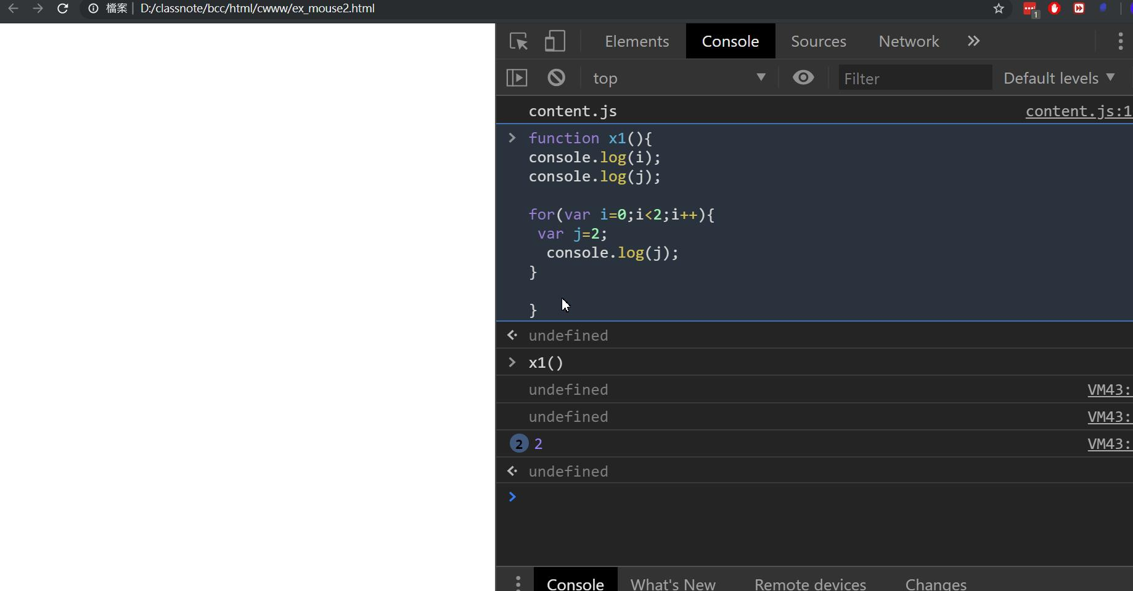
沒有返回值

Slide 9
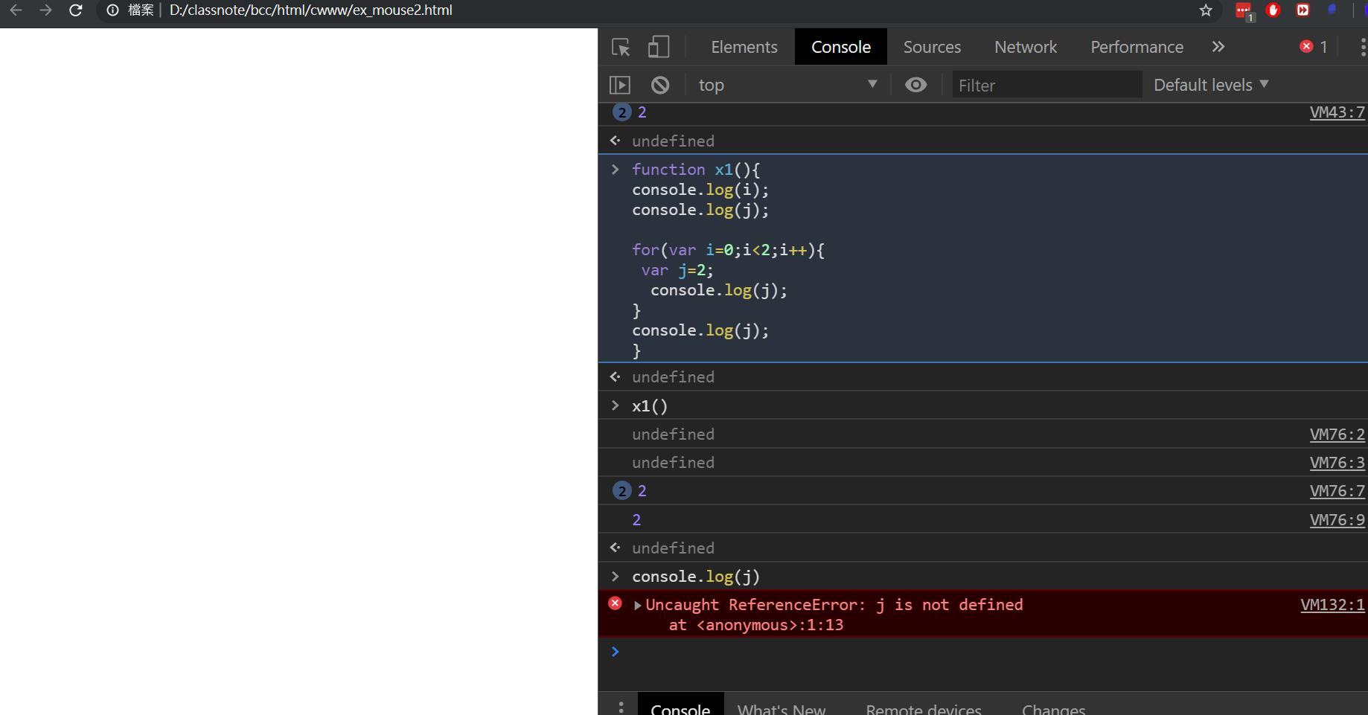
i,j 都被hoisting
function x1(){
var i,j;
console.log(i);
console.log(j);
for(var i;....){
...
var j=3;
}
...
}
只限於function 內

Slide 10
closure

Slide 11
Closure in JavaScript through examples
javascript closureWhat is Closure?
A Closure is a named or anonymous function defined within the context of an object or any other function, which preserves and access to the context where it was declared.
To understand closure, it requires you to be familiar with basic JavaScript concepts, such as scope of variables and functions.

Slide 12
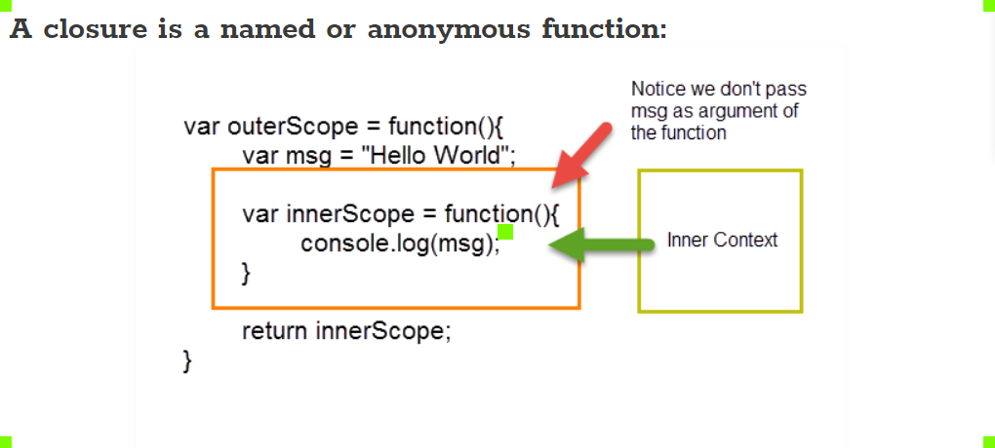

Slide 13
not closure
//Named function
function greetings() { //this is not a closure function.
return ‘Howdy’;
}
//anonimous function
var greetings2 = function () { //this is not a closure function.
return ‘Hello’;
}
greetings(); //Shows Howdy.
greetings2(); //Shows Hello.

